Slide 1
CryptoTitansTM Informed Bitcoin trading
Data ^{X}
Kaz Lewis, Vicente Izquierdo, Pablo Correa, Bode Faleye

Slide 2



Cryptocurrencies and Bitcoin
Cryptocurrencies
Currency built upon computer science, cryptography and economics.
Goal
Decentralized, deflationary trustless currency, platform for smart contracts
Notes:
In the case of ETH, smart contracts to replace large traditional institutions like banks, DMV, insurance, medical records, etc

Slide 3
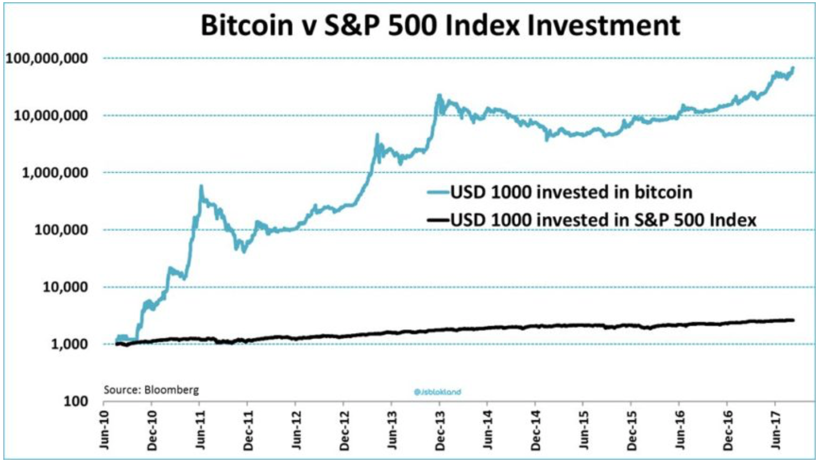
Bitcoin Economics
Market Capitalization
Total = 375 B
Bitcoin = 217 B
Ethereum = 42 B
Altcoins* (> 1B) = 116 B
Bitcoin ROI (vs S&P 500)
5Y = 56,546.16 % (82.36%)
1Y = 824.42 % (21.12%)
1M = 19.21 % (2.22%)
Source: Chart of the Day: Bitcoin vs. S&P, Canadian Investment Review

Slide 4
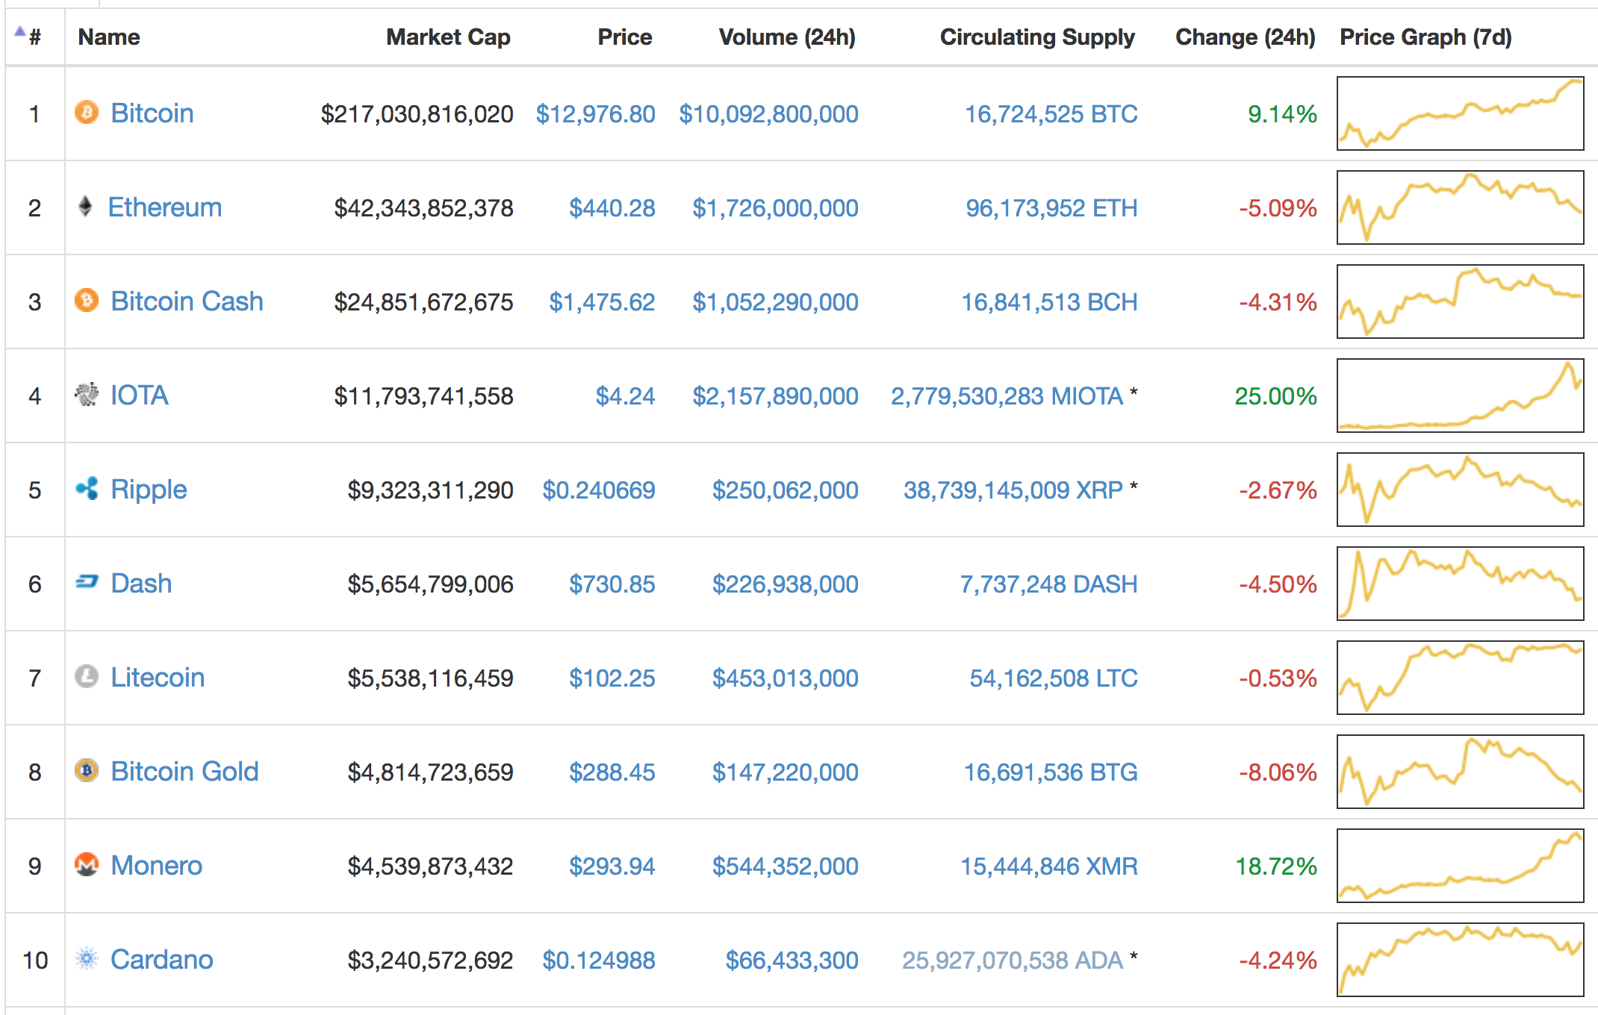
Bitcoin price trend prediction
Main Actors
Traditional Financial Institutions
CME, CBOE groups: Futures trading
Academics: numerous papers over the past few years
Numerai: Cryptocurrency hedge fund
RIALTO.AI: Arbitrage trading fund
Dozens and dozens of others
Notes:
Main actors interested in crypto price fluctuations

Slide 5
Our Vision
Allow a user with no technical expertise or economics background to maximize their return on investment (ROI) through Bitcoin trading through a variety of strategies
Notes:
The vision for this project is to allow a user with no crypto currency experience to be able to maximize their return on investment through tradings bitcoin and other cryptocurrencies

Slide 6
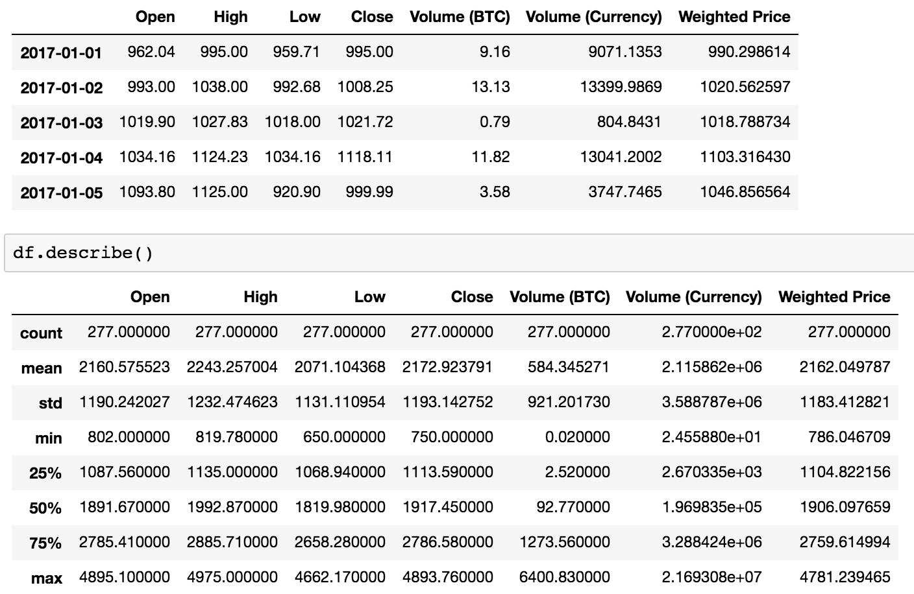

Overall Work Flow
Data Preparation
Model Development
Price Predictions
Data collection, pre-processing, and feature selection
Price prediction on varied timescales
Range of strategies based in traditional TA, machine learning
User-selected timescale for price predictions and trading suggestions
Model
Training
Model
Validation
Parameter Optimization

Slide 7
Project Sample Architecture
Input
Backend
User API
Historical Price Data
Modeling
Bayesian Regression
Neural Networks
Bollinger Bands & Momentum
Price Predictions
Model Selection
Blockchain Transaction Information
Cryptocurrency Exchange API Hook
ROI Outcomes
Short Term
Storage: Pandas
Execution of Trading Strategy
Long Term Feature Weight Storage: CSV
Notes:
Model implementation, training, validation & optimization
First place we have the HPD and BTI, which feed the Machine learning models that determine the price prediction.
The models itself make use of pandas, and store the parameters in csv files to avoid retraining when not necessary.
Finally, the user interface outputs the prediction for the price of the cryptocurrency. Using the credentials and risk profile from the user the trading strategy is executed and its ROI analyzed to tweak the parameters of the model.

Slide 8
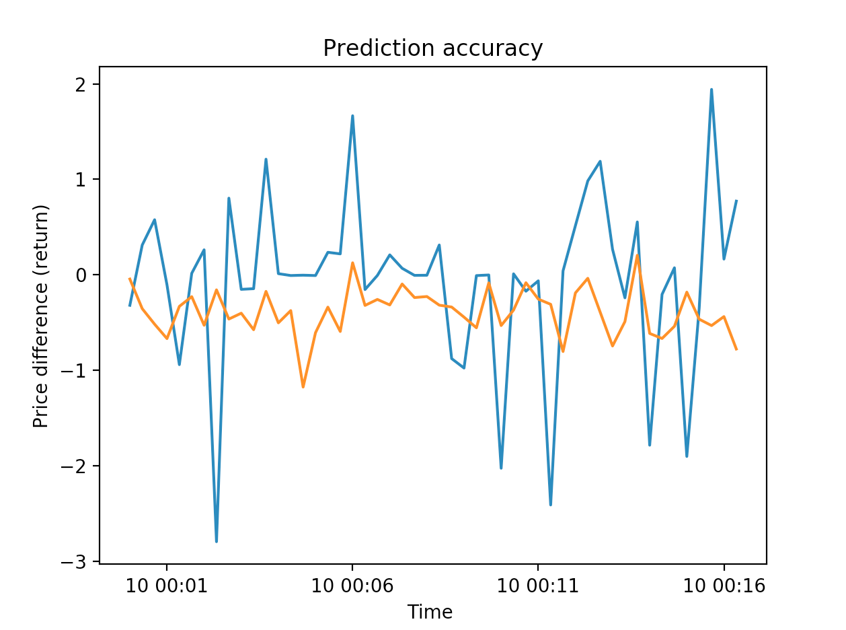
High Frequency Trading: Bayesian Regression
Simplified approach based on Bayesian regression and Bitcoin, MIT
Objectives: Prediction of the movement of the price in a binary way (does it go up or down?) in a short-time scale.
Returns 20s spot-price predictions, ideal for HFT (future trading)
Notes:
The first model we developed is based on a MIT research paper, which aims to make a binary prediction on the movement of the price, not the price itself. In particular, we analyzed for a 20s window, but this can be extended for other timescales. This model is really important in case we want to trade futures or other derivatives.

Slide 9
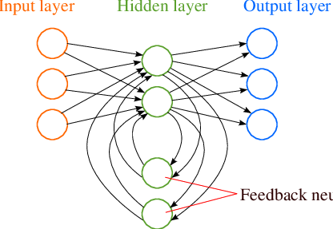
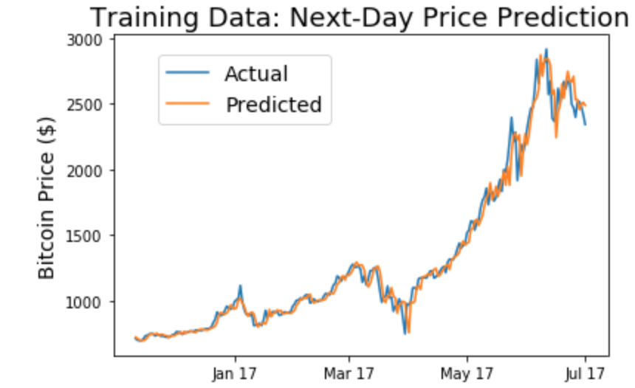
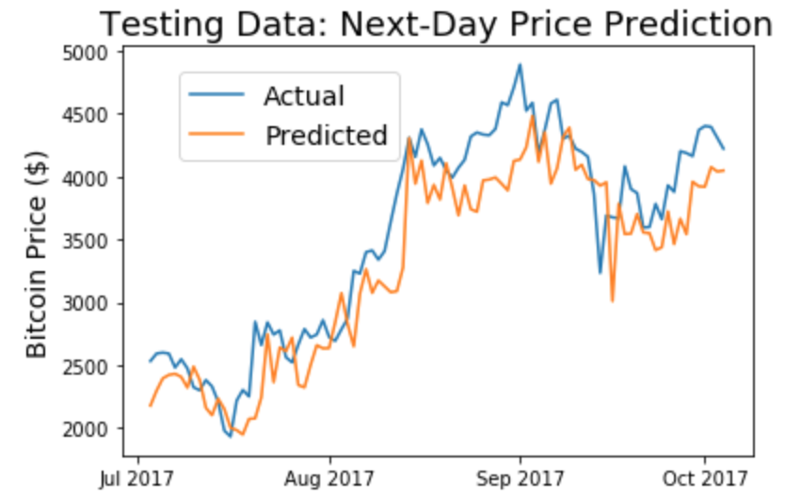
Intra-week Trading: Recurrent Neural Networks
Long Short Term Memory: Allow RNN to select relevant information
Use case: Connect blockchain activity to cryptocurrency exchange price data. Use sliding windows of ‘memory’: ~ 3-7 days
Objective: train a model on previous prices/blockchain data to predict the price x days from now
Notes:
via determination of important parameters for model price prediction

Slide 10
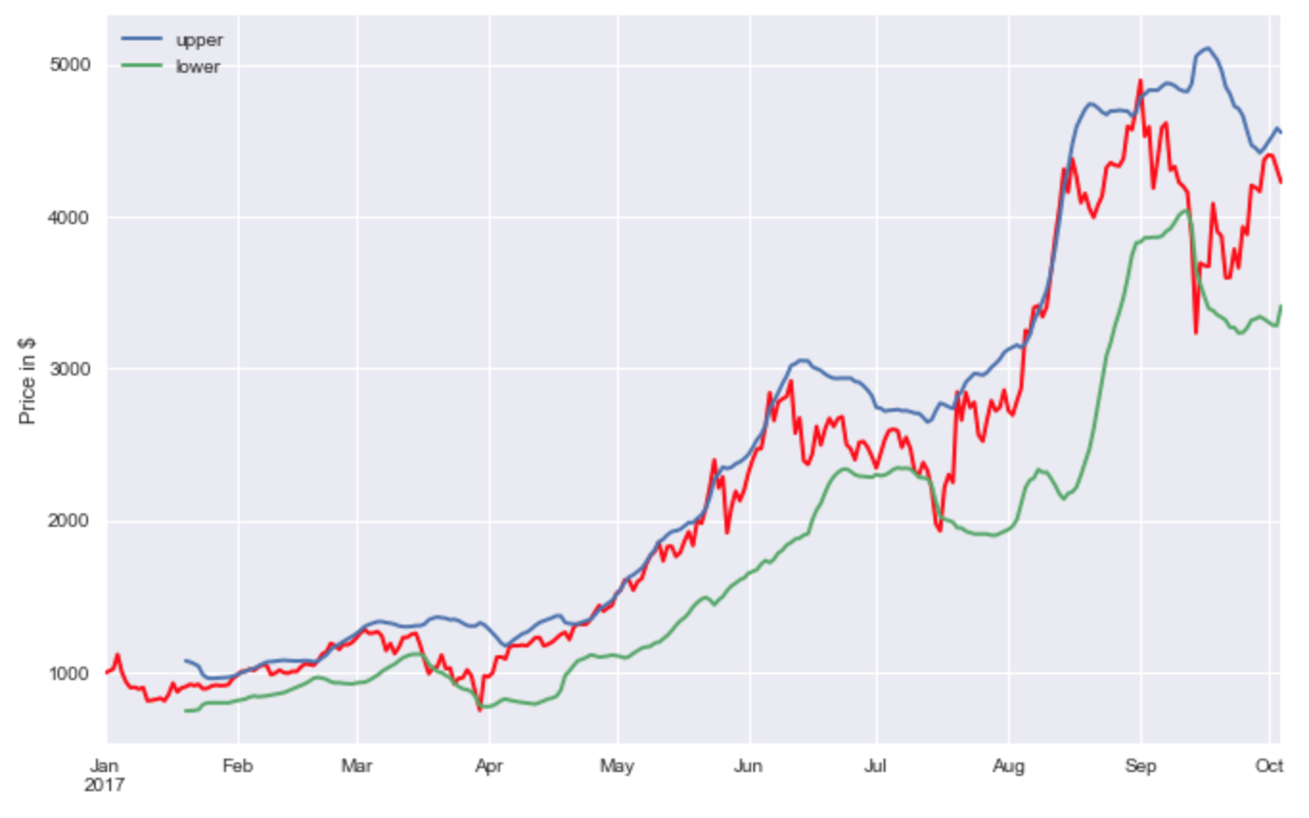

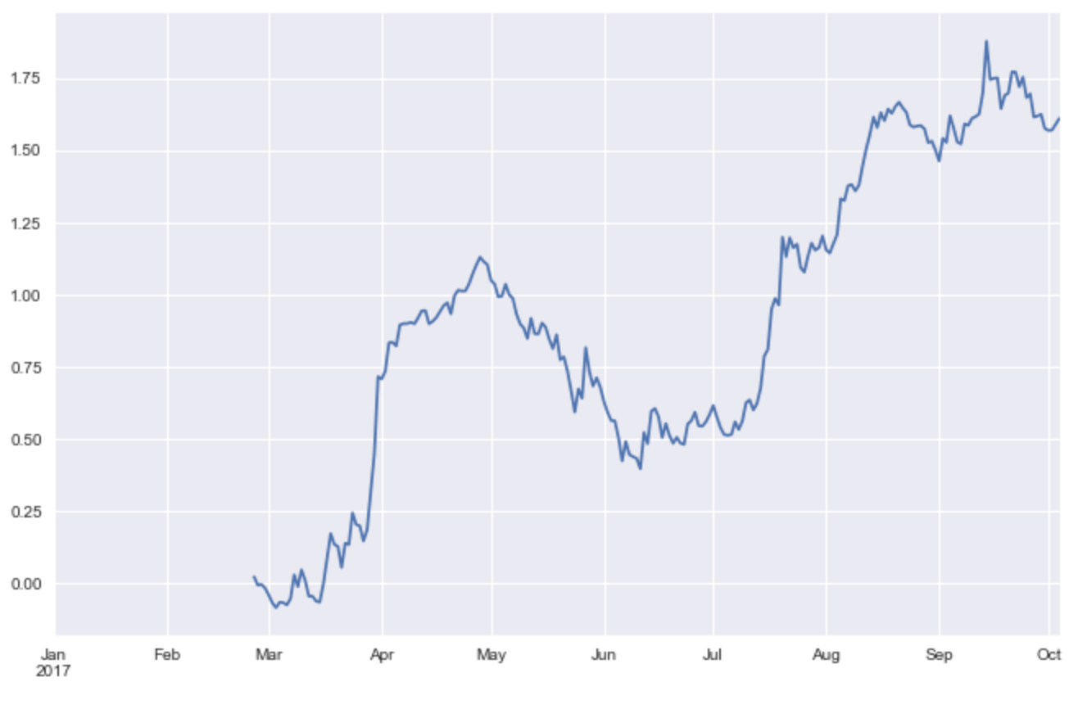
Long Term: Technical Analysis via Bollinger Bands
Trading strategy based on SMA confidence intervals and the behaviour of currency price within it.
Timescale: determined by market trends
Rolling means of prices -> determine buy vs. sell through different set of time windows
BTC Price
Profit Margin

Slide 11


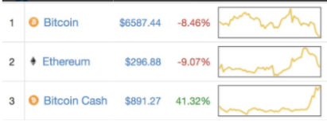
Potential User Interface
Top User Requirements
Performance: Maximize user ROI for a given engagement level (daily, weekly, market-based trading)
Accuracy: Optimize models to, at the very least, prevent loss of user funds
Ease of use: Clean, user-friendly API with push notifications about when to trade (eventual automation)
Portfolio:
Trading Strategy
HFT
Semiweekly
Traditional TA
Notifications +
-Bitcoin 5% Daily Increase
-Skycoin 10% Weekly Increase
Current Suggested Trade:
HOLD BTC

Slide 12
Technical Components of Project
Access to Bitcoin exchange trading data, blockchain transaction data
Data cleanup & feature selection
Training a technical model for price trend prediction
Bayesian regression, neural networks
Internal validation, optimization of technical model
API / User interface with relative ease of use
Select trading strategy, receive trading guidance on relevant timescales
Notes:
Most available data is already relatively clean; relevant feature selection is key

Slide 13
Proposed extensions (Next semester)
Better user interface
Web-based application (AWS / Flask)
Automated trading execution
API hook for cyptocurrency exchanges
Improvements in prediction speed
Cloud-based model data storage to reduce need for re-calculation
Include slippage and transaction costs
Slippage: Impossible to measure (use of estimation algorithms).
Transaction costs: Are different in each exchange.
Allow for user risk tolerance input
Allow the user to set risk tolerance and adjust trading models accordingly (requires to include CAPM portfolio management techniques)

Slide 14
Three informed bitcoin trading models
HFT
Bayesian Regression: instant price predictions
Semiweekly
Recurrent neural networks: semiweekly price predictions
Traditional TA
Bollinger Bands Strategy: Determined by the market

Slide 15

In memoriam
Mit Vipul Dhami (Aug 2017 - Nov 2017)
Thank you for your valuable help and assistance in the early stages of the project.
(Had to drop the class due to a heavy courseload)

Slide 16
Thank you!
Questions and comments?

